Slide 1
Zadní horní hrudní drenáž
T. Ledvina, T. Horváth

Slide 2
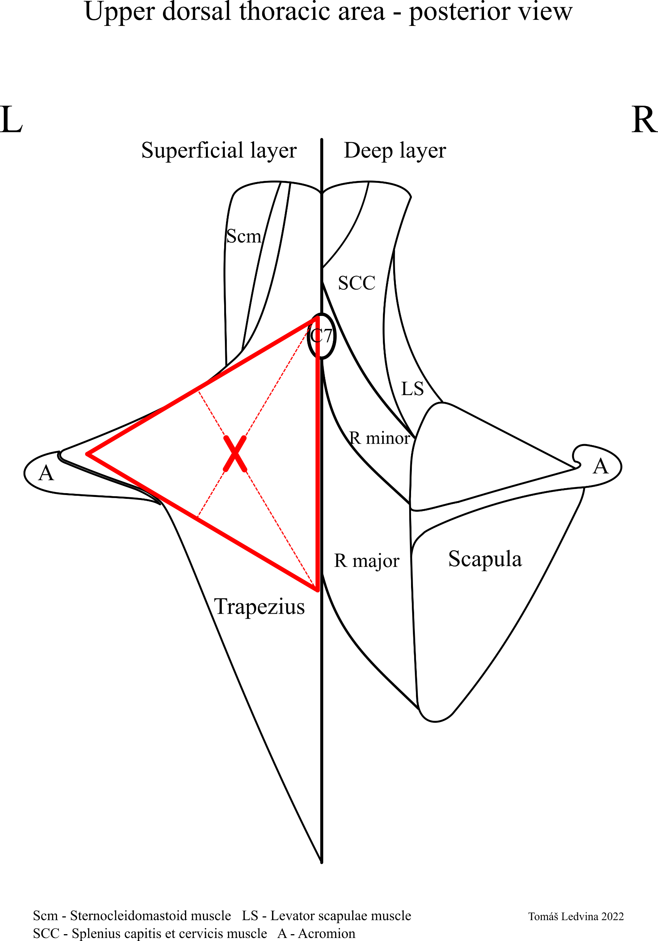

Slide 3
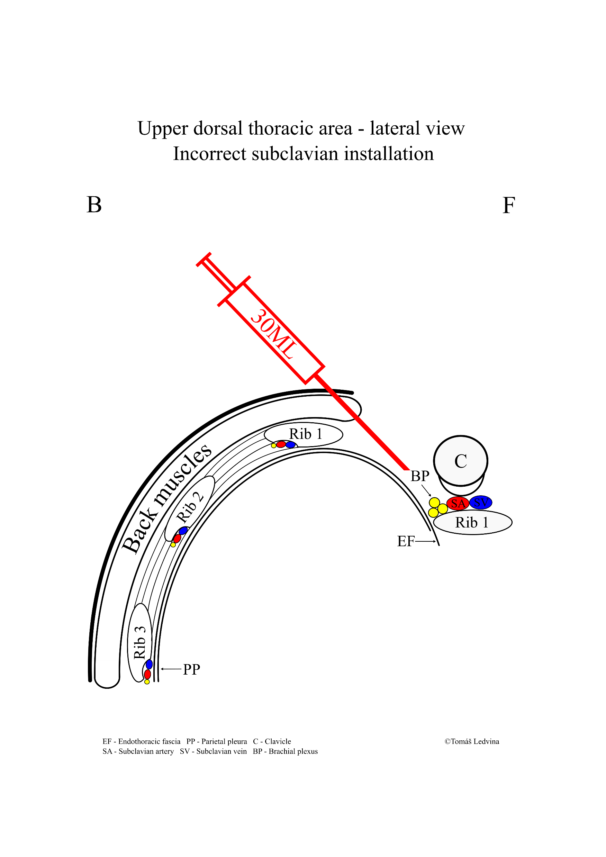
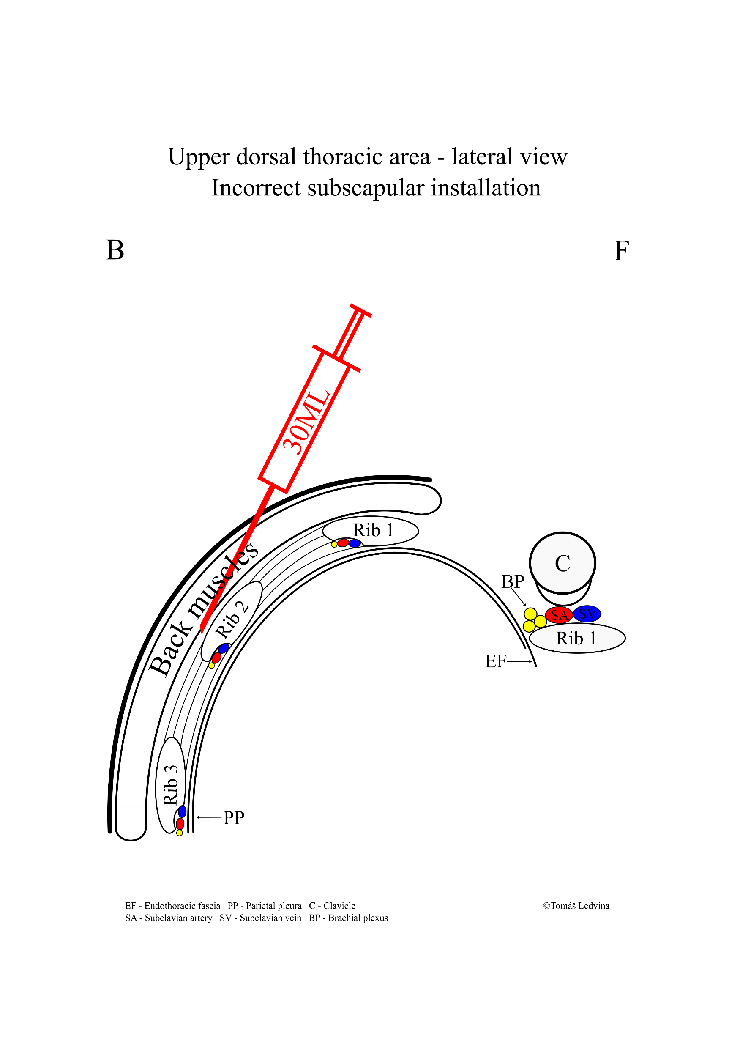
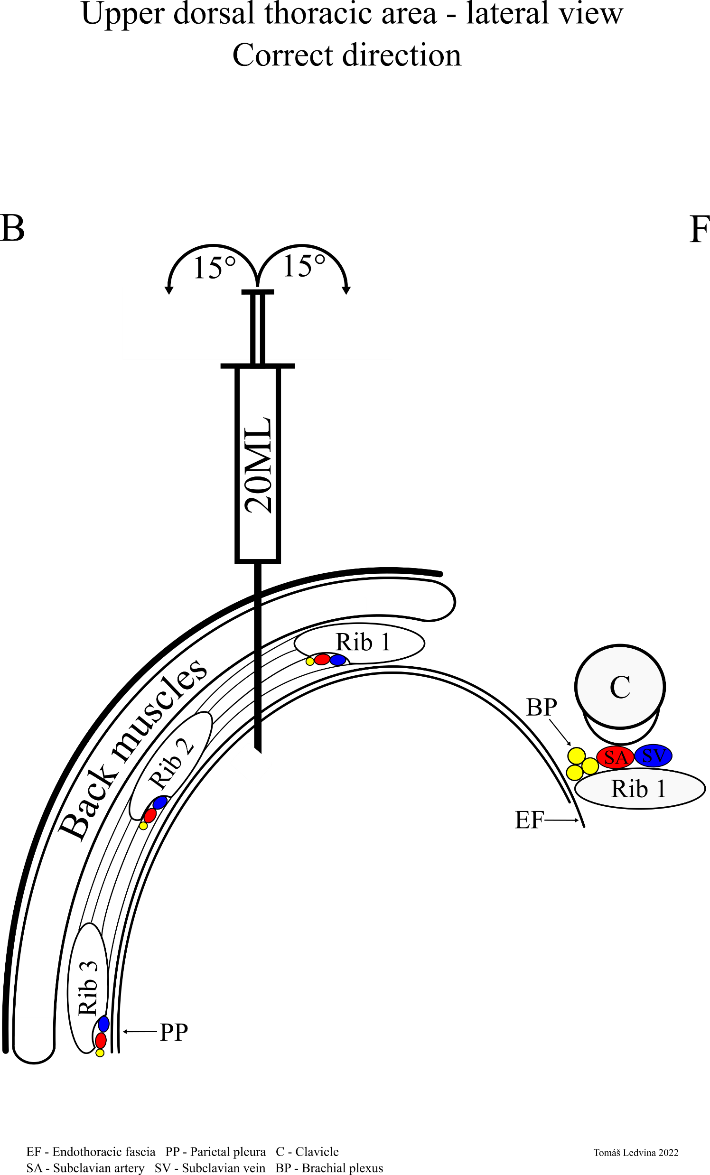

Slide 4
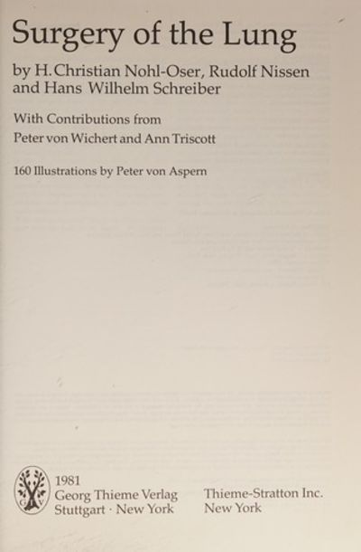
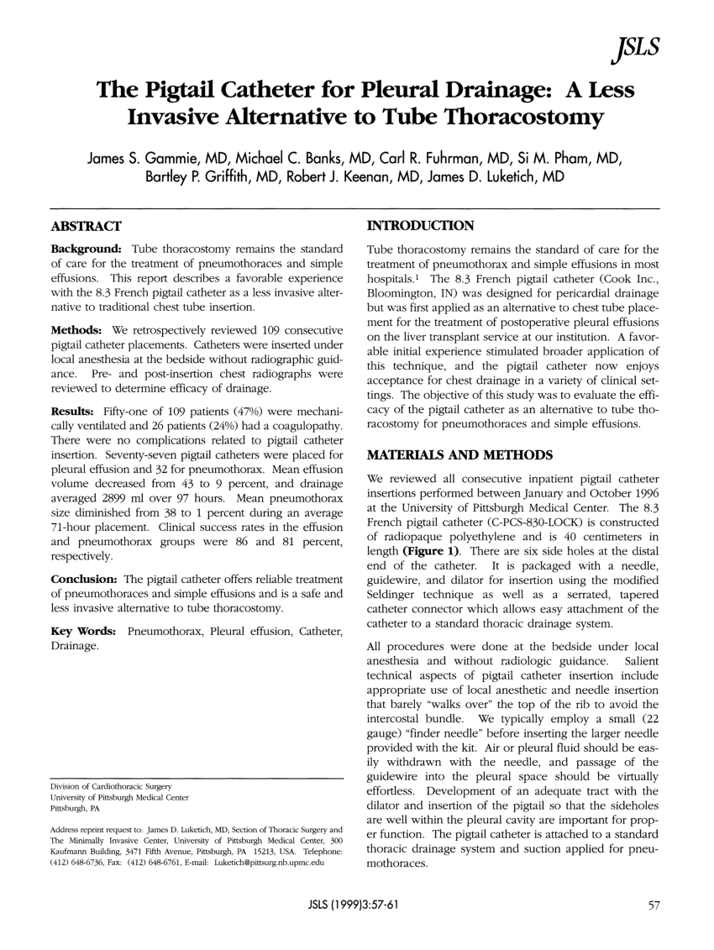
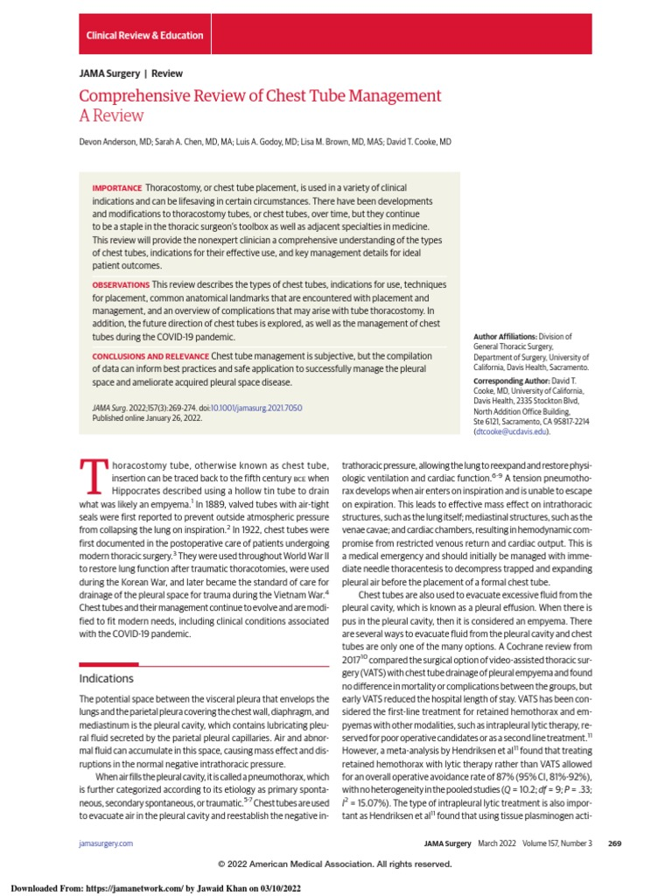
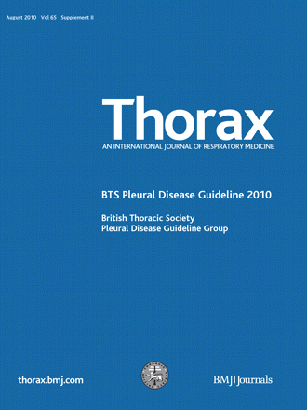

Slide 5
Zdroje
1. Tom Havelock, Richard Teoh, Diane Laws, Fergus Gleeson. Pleural procedures and thoracic ultrasound: British. BTS guidelines. 2010, str. ii69.
2. Hrudní stěna – společně. Pavel Korpa, Teodor Horváth, Tomáš Ledvina. Praha - Emauzy : ČPFS, 2020. Kazuistiky v alergologii, pneumologii a orl, S1 -2020 . str. 30.
3. H. Christian Nohl-Oser, Rudolf Nissen, Hans Wilhelm Schreiber. Intercostal drainage. Surgery of the lung. Stuttgart, New York : GTV, Thieme-Stratton Inc., 1981.
4. I. F. Galvin, J. R. Gibbons, M. Magout, P. Bowe. Placement of an apical chest tube by a posterior intercostal approach. British journal of hospital medicine. 44, 1990, Sv. 330.
5. Edward R. Munnell, MD. Thoracic Drainage. The Society of Thoracic Surgeons. Section of Thoracic and Cardiovascular Surgery. Oklahoma city : Elsevier Science Inc, 1997.

