Slide 1
Perioperační hospodaření se železem
Jan Kamelander
OKH FN Brno

Slide 2
Východiska z ERAS guidelines ESTS (2019)
Předoperační anémie je spojena s pooperační morbiditou, mortalitou a sníženým dlouhodobým přežitím
Rizika operace rostou s tíží anémie
Nutný je předoperační screening anémie i sideropenie, následovaný snahou o identifikaci jejich příčin a včasnou terapii
Tím se sníží rizika plynoucí z anémie, potřeby krevních transfuzí i případné aplikace analog erytropoetinu

Slide 3
Definice anemie se sideropenií před operací
Nejčastější a nejjednodušší definice ve studiích v chirurgii …
Hgb < 130 g/l (u žen Hgb < 120 g/l) a ferritin < 100 µg/l
V terapii recentních studií nejčastěji užita jednorázová aplikace železa v karboxymaltózovém komplexu (= Ferinject) v dávce 1000mg i.v. či 20mg/kg i.v. s dobrou tolerancí

Slide 4
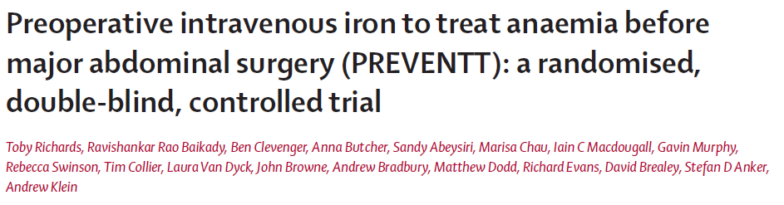
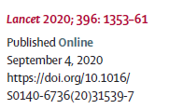
Předoperační železo v břišní chirurgii
Železo aplikované 10-42 dní před velkým břišním operačním výkonem
nesnížilo u pacientů, ve srovnání s placebem, potřebu aplikace transfuzí.
Notes:
Preoperative intravenous iron to treat anaemia before major abdominal surgery (PREVENTT): a randomised, double-blind, controlled trial
Toby Richards, Ravishankar Rao Baikady, Ben Clevenger, Anna Butcher, Sandy Abeysiri, Marisa Chau, Iain C Macdougall, Gavin Murphy, Rebecca Swinson, Tim Collier, Laura Van Dyck, John Browne, Andrew Bradbury, Matthew Dodd, Richard Evans, David Brealey, Stefan D Anker, Andrew Klein
Summary
Background Preoperative anaemia affects a high proportion of patients undergoing major elective surgery and is associated with poor outcomes. We aimed to test the hypothesis that intravenous iron given to anaemic patients before major open elective abdominal surgery would correct anaemia, reduce the need for blood transfusions, and improve patient outcomes.
Methods In a double-blind, parallel-group randomised trial, we recruited adult participants identified with anaemia at preoperative hospital visits before elective major open abdominal surgery at 46 UK tertiary care centres. Anaemia was defined as haemoglobin less than 130 g/L for men and 120 g/L for women. We randomly allocated participants (1:1) via a secure web-based service to receive intravenous iron or placebo 10–42 days before surgery. Intravenous iron was administered as a single 1000 mg dose of ferric carboxymaltose in 100 mL normal saline, and placebo was 100 mL normal saline, both given as an infusion over 15 min. Unblinded study personnel prepared and administered the study drug; participants and other clinical and research staff were blinded to treatment allocation. Coprimary endpoints were risk of the composite outcome of blood transfusion or death, and number of blood transfusions from randomisation to 30 days postoperatively. The primary analysis included all randomly assigned patients with data available for the primary endpoints; safety analysis included all randomly assigned patients according to the treatment received. This study is registered, ISRCTN67322816, and is closed to new participants.
Findings Of 487 participants randomly assigned to placebo (n=243) or intravenous iron (n=244) between Jan 6, 2014, and Sept 28, 2018, complete data for the primary endpoints were available for 474 (97% ) individuals. Death or blood transfusion occurred in 67 (28%) of the 237 patients in the placebo group and 69 (29%) of the 237 patients in the intravenous iron group (risk ratio 1·03, 95% CI 0·78–1·37; p=0·84). There were 111 blood transfusions in the placebo group and 105 in the intravenous iron group (rate ratio 0·98, 95% CI 0·68–1·43; p=0·93). There were no significant differences between the two groups for any of the prespecified safety endpoints.
Interpretation Preoperative intravenous iron was not superior to placebo to reduce need for blood transfusion when administered to patients with anaemia 10–42 days before elective major abdominal surgery.
-----------
Pre‑operative iron increases haemoglobin concentration before abdominal surgery: a systematic review and meta‑analysis of randomized controlled trials
Jeremy Meyer1,2,3*, Roberto Cirocchi4, Salomone Di Saverio5, Frédéric Ris2,3, James Wheeler1 & Richard Justin Davies1
Professional surgical societies recommend the identification and treatment of pre-operative anaemia in patients scheduled for abdominal surgery. Our aim was to determine if pre-operative iron allows correction of haemoglobin concentration and decreased incidence of peri-operative blood transfusion in patients undergoing major abdominal surgery. MEDLINE, Embase and CENTRAL were searched for RCTs written in English and assessing the effect of pre-operative iron on the incidence of perioperative allogeneic blood transfusion in patients undergoing major abdominal surgery. Pooled relative risk (RR), risk difference (RD) and mean difference (MD) were obtained using models with
random effects. Heterogeneity was assessed using the Q-test and quantified using the I2 value. Four RCTs were retained for analysis out of 285 eligible articles. MD in haemoglobin concentration between patients with pre-operative iron and patients without pre-operative iron was of 0.81 g/dl (3 RCTs, 95% CI 0.30 to 1.33, I2: 60%, p = 0.002). Pre-operative iron did not lead to reduction in the incidence of peri-operative blood transfusion in terms of RD (4 RCTs, RD: − 0.13, 95% CI − 0.27 to 0.01, I2: 65%, p = 0.07) or RR (4 RCTs, RR: 0.57, 95% CI 0.30 to 1.09, I2: 64%, p = 0.09). To conclude, pre-operative iron significantly increases haemoglobin concentration by 0.81 g/dl before abdominal surgery but does
not reduce the need for peri-operative blood transfusion. Important heterogeneity exists between existing RCTs in terms of populations and interventions. Future trials should target patients suffering from iron-deficiency anaemia and assess the effect of intervention on anaemia-related complications.

Slide 5
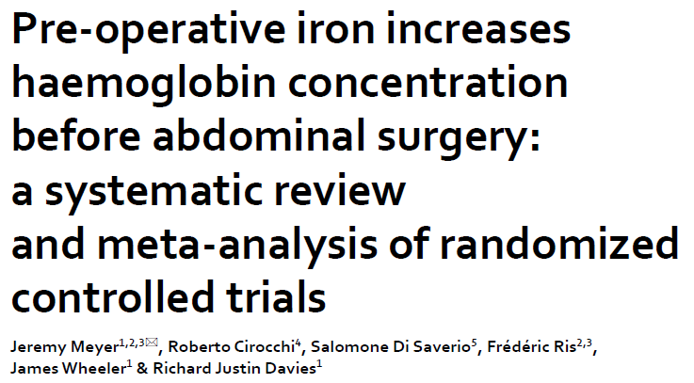
Předoperační železo v břišní chirurgii
Aplikace železa před abdominálními operacemi významně zvýšila koncentraci hemoglobinu (o 8,1 g/l), ale nesnížila potřebu perioperačních transfuzí.
Notes:
Preoperative intravenous iron to treat anaemia before major abdominal surgery (PREVENTT): a randomised, double-blind, controlled trial
Toby Richards, Ravishankar Rao Baikady, Ben Clevenger, Anna Butcher, Sandy Abeysiri, Marisa Chau, Iain C Macdougall, Gavin Murphy, Rebecca Swinson, Tim Collier, Laura Van Dyck, John Browne, Andrew Bradbury, Matthew Dodd, Richard Evans, David Brealey, Stefan D Anker, Andrew Klein
Summary
Background Preoperative anaemia affects a high proportion of patients undergoing major elective surgery and is associated with poor outcomes. We aimed to test the hypothesis that intravenous iron given to anaemic patients before major open elective abdominal surgery would correct anaemia, reduce the need for blood transfusions, and improve patient outcomes.
Methods In a double-blind, parallel-group randomised trial, we recruited adult participants identified with anaemia at preoperative hospital visits before elective major open abdominal surgery at 46 UK tertiary care centres. Anaemia was defined as haemoglobin less than 130 g/L for men and 120 g/L for women. We randomly allocated participants (1:1) via a secure web-based service to receive intravenous iron or placebo 10–42 days before surgery. Intravenous iron was administered as a single 1000 mg dose of ferric carboxymaltose in 100 mL normal saline, and placebo was 100 mL normal saline, both given as an infusion over 15 min. Unblinded study personnel prepared and administered the study drug; participants and other clinical and research staff were blinded to treatment allocation. Coprimary endpoints were risk of the composite outcome of blood transfusion or death, and number of blood transfusions from randomisation to 30 days postoperatively. The primary analysis included all randomly assigned patients with data available for the primary endpoints; safety analysis included all randomly assigned patients according to the treatment received. This study is registered, ISRCTN67322816, and is closed to new participants.
Findings Of 487 participants randomly assigned to placebo (n=243) or intravenous iron (n=244) between Jan 6, 2014, and Sept 28, 2018, complete data for the primary endpoints were available for 474 (97% ) individuals. Death or blood transfusion occurred in 67 (28%) of the 237 patients in the placebo group and 69 (29%) of the 237 patients in the intravenous iron group (risk ratio 1·03, 95% CI 0·78–1·37; p=0·84). There were 111 blood transfusions in the placebo group and 105 in the intravenous iron group (rate ratio 0·98, 95% CI 0·68–1·43; p=0·93). There were no significant differences between the two groups for any of the prespecified safety endpoints.
Interpretation Preoperative intravenous iron was not superior to placebo to reduce need for blood transfusion when administered to patients with anaemia 10–42 days before elective major abdominal surgery.
-----------
Pre‑operative iron increases haemoglobin concentration before abdominal surgery: a systematic review and meta‑analysis of randomized controlled trials
Jeremy Meyer1,2,3*, Roberto Cirocchi4, Salomone Di Saverio5, Frédéric Ris2,3, James Wheeler1 & Richard Justin Davies1
Professional surgical societies recommend the identification and treatment of pre-operative anaemia in patients scheduled for abdominal surgery. Our aim was to determine if pre-operative iron allows correction of haemoglobin concentration and decreased incidence of peri-operative blood transfusion in patients undergoing major abdominal surgery. MEDLINE, Embase and CENTRAL were searched for RCTs written in English and assessing the effect of pre-operative iron on the incidence of perioperative allogeneic blood transfusion in patients undergoing major abdominal surgery. Pooled relative risk (RR), risk difference (RD) and mean difference (MD) were obtained using models with
random effects. Heterogeneity was assessed using the Q-test and quantified using the I2 value. Four RCTs were retained for analysis out of 285 eligible articles. MD in haemoglobin concentration between patients with pre-operative iron and patients without pre-operative iron was of 0.81 g/dl (3 RCTs, 95% CI 0.30 to 1.33, I2: 60%, p = 0.002). Pre-operative iron did not lead to reduction in the incidence of peri-operative blood transfusion in terms of RD (4 RCTs, RD: − 0.13, 95% CI − 0.27 to 0.01, I2: 65%, p = 0.07) or RR (4 RCTs, RR: 0.57, 95% CI 0.30 to 1.09, I2: 64%, p = 0.09). To conclude, pre-operative iron significantly increases haemoglobin concentration by 0.81 g/dl before abdominal surgery but does
not reduce the need for peri-operative blood transfusion. Important heterogeneity exists between existing RCTs in terms of populations and interventions. Future trials should target patients suffering from iron-deficiency anaemia and assess the effect of intervention on anaemia-related complications.

Slide 6
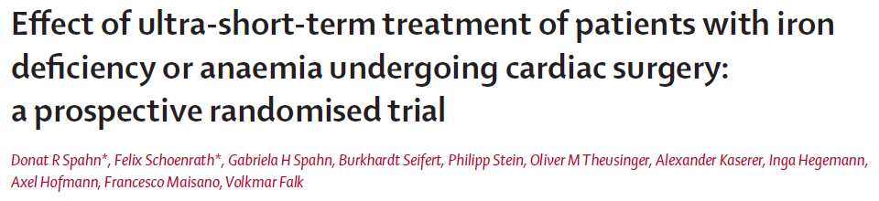
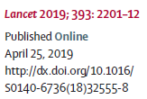
Předoperační železo v kardiochirurgii
Fe-karboxymaltoza 1000mg + EPO 40000IU + 1mg B12 + 5mg folát
– snížena potřeba transfuzí o 1 balení do 7 i 90 pooper. dne, zvýšen Hgb …
Notes:
Effect of ultra-short-term treatment of patients with iron deficiency or anaemia undergoing cardiac surgery: a prospective randomised trial
Donat R Spahn*, Felix Schoenrath*, Gabriela H Spahn, Burkhardt Seifert, Philipp Stein, Oliver M Theusinger, Alexander Kaserer, Inga Hegemann,
Axel Hofmann, Francesco Maisano, Volkmar Falk
Summary
Background Anaemia and iron deficiency are frequent in patients scheduled for cardiac surgery. This study assessed
whether immediate preoperative treatment could result in reduced perioperative red blood cell (RBC) transfusions
and improved outcome.
Methods In this single-centre, randomised, double-blind, parallel-group controlled study, patients undergoing elective
cardiac surgery with anaemia (n=253; haemoglobin concentration (Hb) <120 g/L in women and Hb <130 g/L in men)
or isolated iron deficiency (n=252; ferritin <100 mcg/L, no anaemia) were enrolled. Participants were randomly
assigned (1:1) with the use of a computer-generated range minimisation (allocation probability 0・8) to receive either
placebo or combination treatment consisting of a slow infusion of 20 mg/kg ferric carboxymaltose, 40 000 U
subcutaneous erythropoietin alpha, 1 mg subcutaneous vitamin B12, and 5 mg oral folic acid or placebo on the day
before surgery. Primary outcome was the number of RBC transfusions during the first 7 days. This trial is registered
with ClinicalTrials.gov, number NCT02031289.
Findings Between Jan 9, 2014, and July 19, 2017, 1006 patients were enrolled; 505 with anaemia or isolated iron
deficiency and 501 in the registry. The combination treatment significantly reduced RBC transfusions from a
median of one unit in the placebo group (IQR 0–3) to zero units in the treatment group (0–2, during the first
7 days (odds ratio 0・70 [95% CI 0・50–0・98] for each threshold of number of RBC transfusions, p=0・036) and
until postoperative day 90 (p=0・018). Despite fewer RBC units transfused, patients in the treatment group had a
higher haemoglobin concentration, higher reticulocyte count, and a higher reticulocyte haemoglobin
content during the first 7 days (p≤0・001). Combined allogeneic transfusions were less in the treatment
group (0 [IQR 0–2]) versus the placebo group (1 [0–3]) during the first 7 days (p=0・038) and until postoperative
day 90 (p=0・019). 73 (30%) serious adverse events were reported in the treatment group group versus 79 (33%) in
the placebo group.
Interpretation An ultra-short-term combination treatment with intravenous iron, subcutaneous erythropoietin
alpha, vitamin B12, and oral folic acid reduced RBC and total allogeneic blood product transfusions in patients with
preoperative anaemia or isolated iron deficiency undergoing elective cardiac surgery.

Slide 7
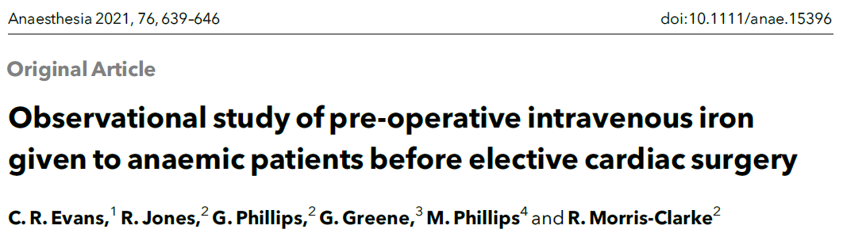
Předoperační železo v kardiochirurgii
Ferinject 20mg/kg, u léčených pacientů růst Hgb a při dosažení předoper.
Hgb > 130g/l pak i snížení pravděpodobnosti potřeby transfuzní terapie
u 54% z nich vs. u 28% těch, co nedosáhli hranice 130g/l a 22% neléčených.
Notes:
Observational study of pre-operative intravenous iron given to anaemic patients before elective cardiac surgery
C. R. Evans,1 R. Jones,2 G. Phillips,2 G. Greene,3 M. Phillips4 and R. Morris-Clarke2
1 Consultant, 2 Specialist Registrar, Department of Anaesthesia, 4 Nurse Case Manager, Department of Cardiothoracic
Surgery, University Hospital of Wales, Cardiff, UK
3 Lecturer, Department of Statistics, Cardiff University, Cardiff, UK
Summary
Cardiac surgical patients with anaemia experience increased morbidity and mortality. Iron deficiency is the
most common cause of pre-operative anaemia in this group. We designed and implemented the Cardiff
Pathway, a pre-assessment and treatment pathway to identify cardiac surgical patients with anaemia and iron
deficiency. Patients identified with anaemia and/or iron deficiency (Hb < 130 g.l-1 and ferritin < 100 lg.l-1) were
offered intravenous iron infusion 20 mg.kg-1 pre-operatively. Treatment success was defined as Hb ≥ 130g.l-1 on
the day of surgery. We analysed data from 447 patients: 300 (67%) were not anaemic; 75 (17%) were anaemic
and treated with intravenous iron; and 72 (16%) were anaemic and not treated. Haemoglobin concentration
increased in successfully treated anaemic patients by a mean (95%CI) of 17 (13–21) g.l-1 and they received a
median (IQR [range]) of 0 (0–2 [0–15]) units of blood peri-operatively. Transfusion was avoided in 54% of the
successfully treated anaemic patients, which was significantly more than the unsuccessfully treated anaemic
(22%, p = 0.005) and untreated anaemic (28%, p = 0.018) patients and similar to non-anaemic patients who
received a median (IQR [range] of 0 (0–1 [0–16])) units of blood and, 63% avoided transfusion). Mean (95%CI)
Hb fell between pre-assessment and surgery in the untreated anaemic (-2 (0 to -4) g.l-1) and non-anaemic
groups (-2 (-1 to -3) g.l-1). Twenty-one (7%) of the non-anaemic group became newly anaemic waiting for
surgery. The Cardiff Pathway reliably identified patients with anaemia and iron deficiency. Anaemic patients
who had their Hb restored to normal after treatment required less blood peri-operatively and over half of them
required no transfusion at all.

Slide 8
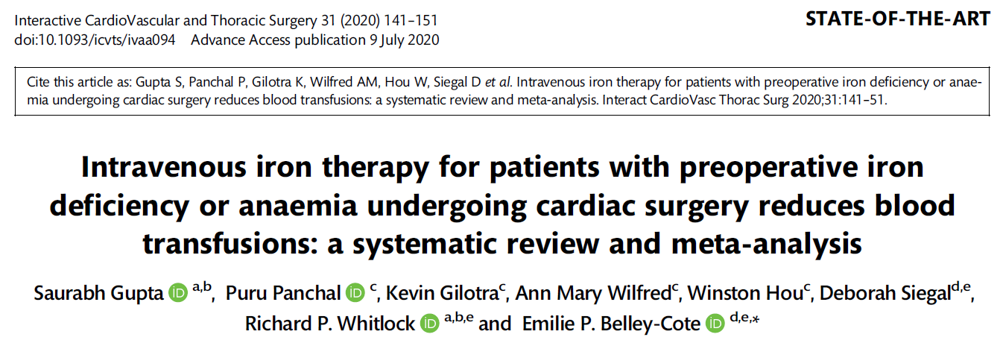
Metaanalýza z kardiochirurgie

Slide 9
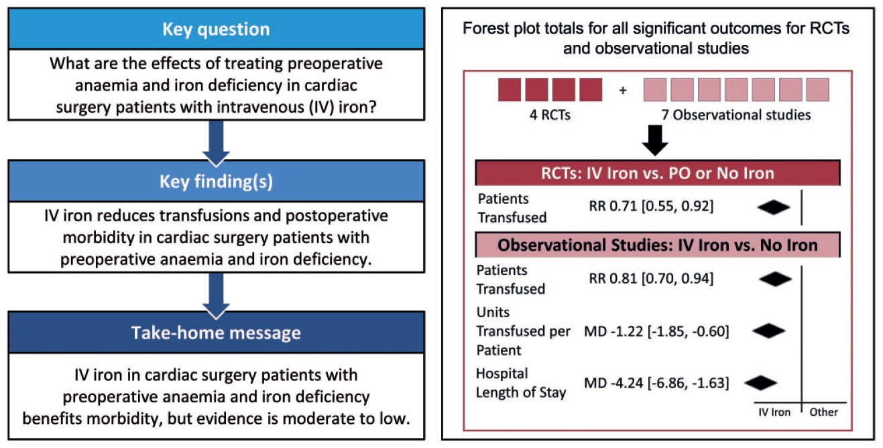
Metaanalýza z kardiochirurgie
Notes:
Gupta S, Panchal P, Gilotra K, Wilfred AM, Hou W, Siegal D et al. Intravenous iron therapy for patients with preoperative iron deficiency or anaemia
undergoing cardiac surgery reduces blood transfusions: a systematic review and meta-analysis. Interact CardioVasc Thorac Surg 2020;31:141–51.
Abstract
OBJECTIVES: The benefits of preoperative intravenous (IV) iron treatment in cardiac surgery patients with preoperative anaemia or iron
deficiency have not been well-established. We performed a systematic review and meta-analysis to determine the effects of treating preoperative
anaemia or iron deficiency with IV iron in adult cardiac surgery patients.
ADULT CARDIAC
VC The Author(s) 2020. Published by Oxford University Press on behalf of the European Association for Cardio-Thoracic Surgery. All rights reserved.
Interactive CardioVascular and Thoracic Surgery 31 (2020) 141–151 STATE-OF-THE-ART
doi:10.1093/icvts/ivaa094 Advance Access publication 9 July 2020
Downloaded from https://academic.oup.com/icvts/article/31/2/141/5869069 by FN Brno user on 03 January 2023
METHODS: We searched Cochrane Central Register of Controlled Trials, Medical Literature Analysis and Retrieval Systems Online and
Excerpta Medica Database for randomized controlled trials (RCTs) and observational studies comparing IV iron to oral iron or no iron. We
performed title and abstract, full-text screening, data extraction and risk of bias assessment independently and in duplicate. We pooled
data using a random effects model and evaluated the overall quality of evidence.
RESULTS: We identified 4 RCTs and 7 observational studies. Pooled data from observational studies suggested a benefit of IV iron compared
to no iron on mortality [relative risk 0.39, 95% confidence interval (CI) 0.23–0.65; P < 0.001, very low quality], units transfused per patient
(mean difference -1.22, 95% CI -1.85 to -0.60; P < 0.001, very low quality), renal injury (relative risk 0.50, 95% CI 0.36–0.69; P < 0.001,
very low quality) and hospital length of stay (mean difference -4.24 days, 95% CI -6.86 to -1.63; P = 0.001, very low quality). Pooled data
from RCTs demonstrated a reduction in the number of patients transfused with IV iron compared to oral or no iron (relative risk 0.81, 95%
CI 0.70–0.94; P = 0.005, moderate quality). The pooled estimates of effect from RCTs for mortality, hospital length of stay, units transfused
per patient and renal injury were consistent in direction with observational studies.
CONCLUSIONS: This meta-analysis suggests that IV iron improves postoperative morbidity in adult cardiac surgery patients with preoperative
anaemia or iron deficiency. A large, rigorous, placebo-controlled, double-blinded, multicentre trial is needed to clarify the role of IV
iron in this patient population.
Clinical trial registration: International prospective register of systematic reviews ID Number CRD42019122844

Slide 10
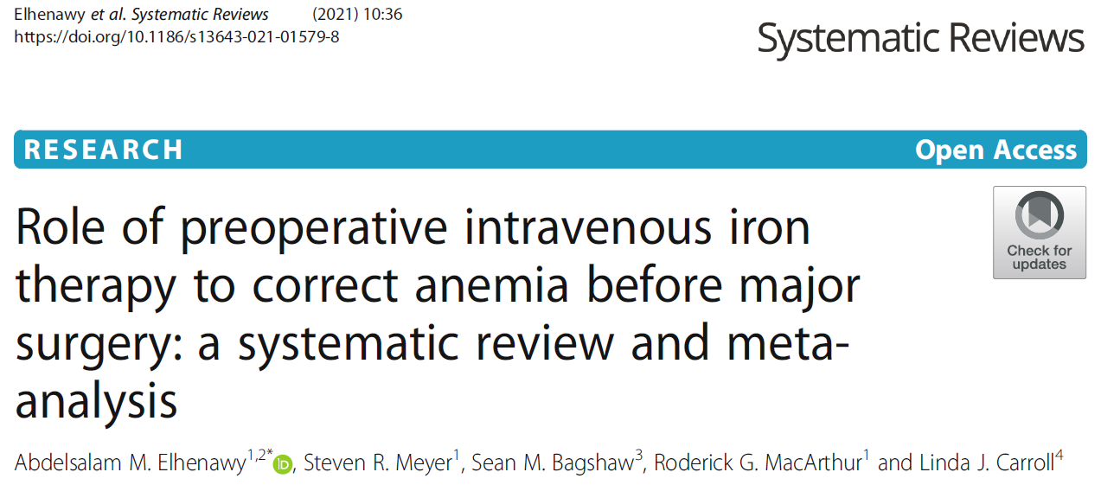
Metaanalýza z různých chirurgických oborů
10 RCT: břišní chirurgie, kardiochirurgie, gynekologie, ortopedie (1999 – 2016).
Snížení rizika potřeby alogenních transfuzí o 16% (RR 0,84), zvýšení koncentrace
hemoglobinu preoperačně (o 7,15g/l) i za 4 týdny po operaci (o 6,46g/l)
– vše ve srovnání s placebem či perorální aplikací železa
Notes:
Elhenawy et al. Systematic Reviews (2021) 10:36
https://doi.org/10.1186/s13643-021-01579-8
Abstract
Background: Preoperative anemia is a common comorbidity that often necessitates allogeneic blood transfusion
(ABT). As there is a risk associated with blood transfusions, preoperative intravenous iron (IV) has been proposed to
increase the hemoglobin to reduce perioperative transfusion; however, randomized controlled trials (RCT)
investigating this efficacy for IV iron are small, limited, and inconclusive. Consequently, a meta-analysis that pools
these studies may provide new and clinically useful information.
Methods/design: Databases of MEDLINE, EMBASE, EBM Reviews; Cochrane-controlled trial registry; Scopus;
registries of health technology assessment and clinical trials; Web of Science; ProQuest Dissertations and Theses;
Clinicaltrials.gov; and Conference Proceedings Citation Index-Science (CPCI-S) were searched. Also, we screened all
the retrieved reference lists.
Selection criteria: Titles and abstracts were screened for relevance (i.e., relevant, irrelevant, or potentially relevant).
Then, we screened full texts of those citations identified as potentially applicable.
Results: Our search found 3195 citations and ten RCTs (1039 participants) that met our inclusion criteria.
Preoperative IV iron supplementation significantly decreases ABT by 16% (risk ratio (RR): 0.84, 95% confidence
interval [CI]: 0.71, 0.99, p = 0.04). In addition, preoperatively, hemoglobin levels increased after receiving IV iron
(mean difference [MD] between the study groups: 7.15 g/L, 95% CI: 2.26, 12.04 g/L, p = 0.004) and at follow-up > 4
weeks postoperatively (MD: 6.46 g/L, 95% CI: 3.10, 9.81, p = 0.0002). Iron injection was not associated with increased
incidence of non-serious or serious adverse effects across groups (RR: 1.13, 95% CI: 0.78, 1.65, p = 0.52) and (RR: 0.96,
95% CI: 0.44, 2.10, p = 0.92) respectively.
Conclusions: With moderate certainty, due to the high risk of bias in some studies in one or two domains, we
found intravenous iron supplementation is associated with a significant decrease in the blood transfusions rate, and
modest hemoglobin concentrations rise when injected pre-surgery compared with placebo or oral iron
supplementation. However, further full-scale randomized controlled trials with robust methodology are required. In
particular, the safety, quality of life, and cost-effectiveness of different intravenous iron preparations require further
evaluation.

Slide 11
Závěrem
Anemie + sideropenie = Hgb < 130 g/l + ferritin < 100 µg/l
Th před operací: Ferinject 1000 mg i.v. (+/- další mikronutrienty)
- dobrá tolerance, alternativy méně efektivní … Ferrlecit 62,5 mg i.v./D
- není plně hrazen v ČR ze ZP (doplatek cca 1400 Kč/500 mg)
Efekt na růst Hgb pravděpodobný, úspora transfuzí možná ??
Pokračovat v terapii anemie + sideropenie i po operaci… spolupráce
Notes:
Pozn.: (pro plicní chirurgii jsem studie na uvedené téma k 9.1.2023 nenalezl)

Slide 12
Děkuji za pozornost
Zda uvedené zkusíte, je na vás …

