Slide 1




Program
Časného záchytu karcinomu plic
N.B. MB0
C2 OPTIMALIZACE 1_2023
Horváth T, Chirurgická klinika FN a LF MU Brno

Slide 2
Let´s learn more about our past to make our future brighter
W. Churchill

Slide 3
Lung Projects in ´80
Mayo Clinic
John Hopkins
MSCC
Czechoslovak Trial
Fontana RS, Sanderson DR , Woolner LB, et al. Screening for lung cancer. A critique of the Mayo Lung Project. Cancer 1991 15;67:1155-64.
Kubík A, Parkin DM, Khlat M, Erban J, Polák J, Adamec M. Lack of benefit from semi-annual screening for cancer of the lung: follow-up report of
a randomized controlled trial on a population of high-risk males in Czechoslovakia. Int J Cancer 1990; 45: 26– 33.

Slide 4
RIZIKOVÁ SKUPINA ´97-21
n=973 536 F / 437M x ~ 62y
40 susp. lézí T1a
Horvath T, Spelda S, Prasek M et al. Časná diagnóza plicní malignity ve spojení s časnou pneumochirurgií představují vysoce účinnou léčbu
Klin onkol 2022;35,S1:93

Slide 5
Dg T1a (n=40)
Histol pT1a (n=34)
Maligní 34
Plicní primum 18 + 4 metachronní plicní primum
Solitární plicní mts extrapulmonální rakoviny 12
(5 GIT, 3 UROL, 2 MAMMA, 1 GYN, 1 MM)
Benigní 2
Chondrohamartom
Ostatní 4
2 granulom, 1 plicní infarkt, 1 perif. lymphadenopatie
(premaligní AAH, DIPNECH)

Slide 6
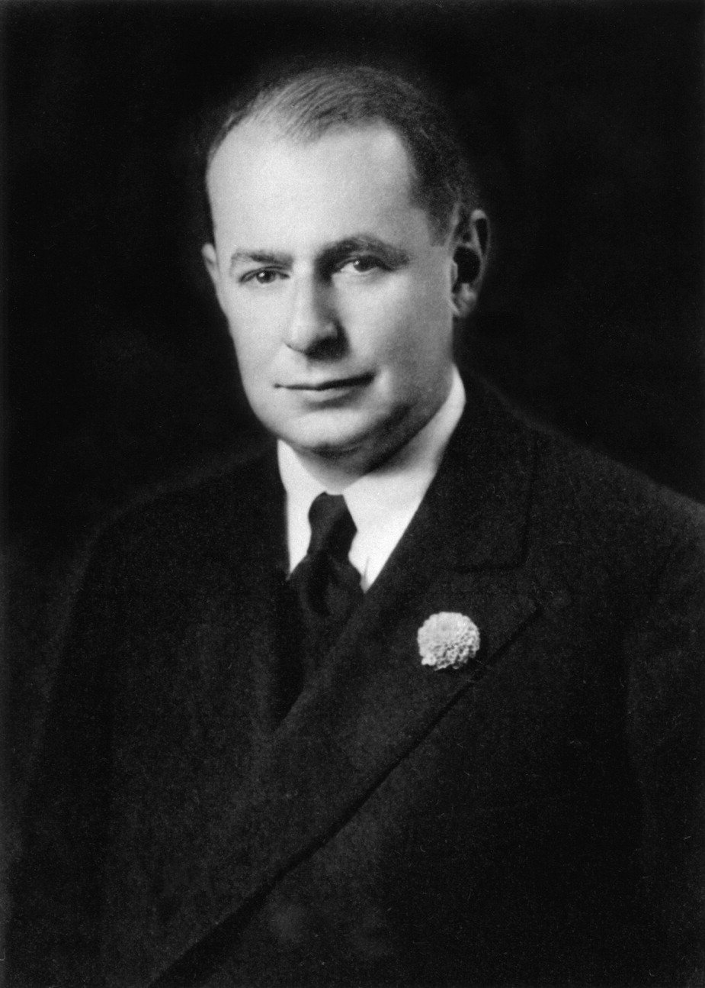

By daring amount
of optimism would
be anticipated the time
of complete pulmonary
resection due cancer
joined careful lymphatic
dissection.
1932
Ed Churchill

Slide 7
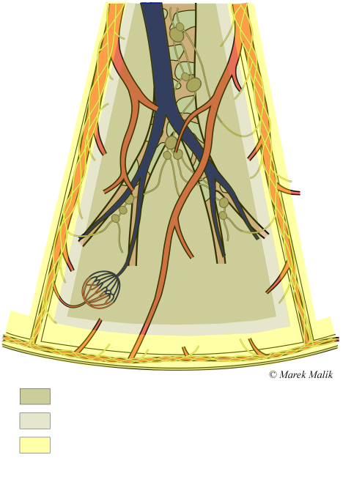
Overholt SE n=26
LR 0
VATS SE n=8
LR 2

Slide 8


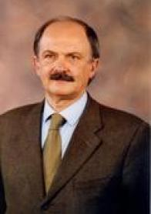
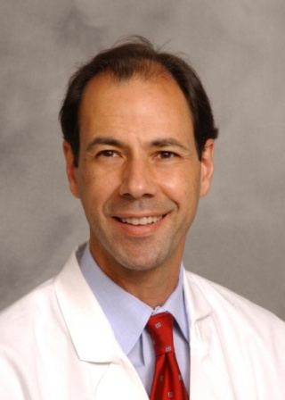


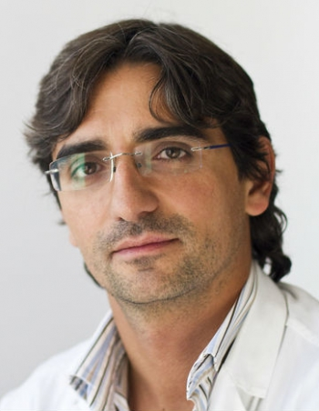
VATS era
Jin-Shing Chen
Early 90´
Threeportal
Late 90´
Ming-Hui Hung
Ya-Jung Cheng
Robert McKenna
Giancarlo Roviaro
st
nd
1 d 3M double port
2 d 3M uniportal
NITS
Thomas D´Amico
Alan DL Sihoe
Gaetano Rocco
Diego Gonzales Rivas

Slide 9
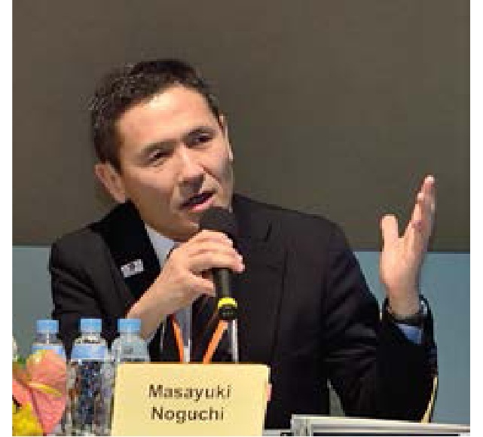
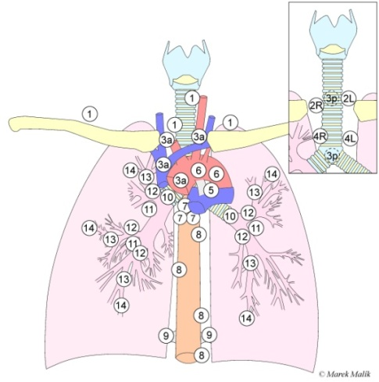
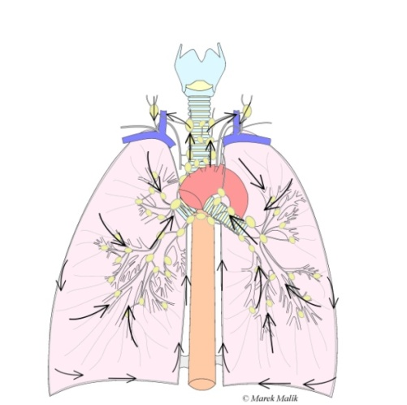
MTS potential peripheral ADL
% lymphatic MTS
LBAC 0% LBACka 0% LBACfp 28%
papADL 25% ADL G3 48% tubADL 58%
LBAC – Lokalized Bronchioloalveolar Lung Carcinoma: non-invasive
LBACak – LBAC focuses with collapsed alveolar structure
LBACfp – fibroblastic proliferation
PapADL – papilar pulmonary adenocarcinoma
TubADL – tubular pulmonary adenocarcinoma
Noguchi M, Morikawa A, Kawasaki M, Matsuno Y, Yamada T, Hirohashi S, Kondo H, Shimosato Y. Small
adenocarcinoma of the lung. Cancer 1995; 75:2844-2852.

Slide 10
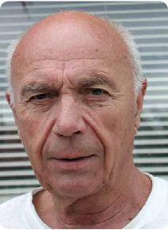
„Nádor jde nejlépe léčit když je malý a dá se vyříznout“
Zdeněk Mechl

Slide 11

EARLY LUNG CANCER ACTION PROJECT
CT screening significantly
reduces lung cancer
mortality
Claudia I. Henschke
Henschke CI, Miettinen OS, Yankelewitz DF, Libby DM, Smith JP Radiographic screening for cancer: proposed paradigm for requisite research
Clin Imag 1994;18: 16-20
Henschke CI,Bofetta P, Gorlova O, Yip R, DeLancey JO, Foy M Lung Cancer 2011; 71: 328-332 Assessment of lung-cancer mortality reduction from CT Screening

Slide 12

Preinvasive lesion
SQL/SD; ADL /AAH
DIPNECH / PNET; SCLC
DIPNECH – Diffuse idiopathic pulmonary neuroendocrine cell hyperplasia
SCLC – Small cell lung cancer
SQL/SD – Squamous cell lung cancer / Severe dysplasia
ADL / AAH – Lung adenocarcinoma / atypical alveolar hyperplasia
Kerr KM. Pulmonary preinvasive neoplasia. J Clin Pathol 54(4):257-71; 2001
Keith M. Kerr

Slide 13
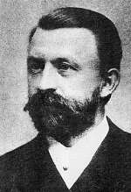

“Léčil jste pacienta skalpelem ?
Jste za něj zodpovědný
celý život. “
Karel Maydl

