Slide 1




Regulace dýchání
Jan Ledvina
Tomáš Ledvina

Slide 2
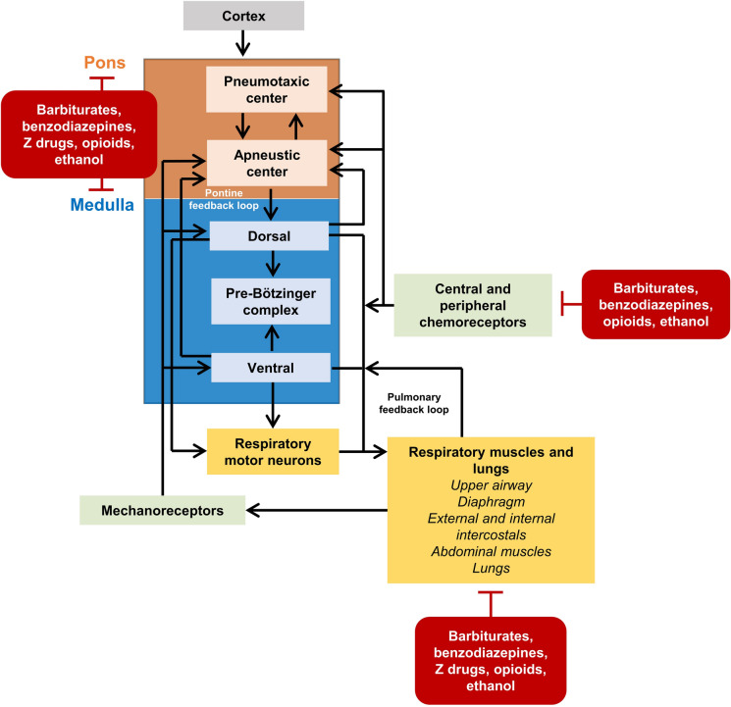
Tento obrázek byl převzat z Webster LR, Karan S. The Physiology and Maintenance of Respiration: A Narrative Review. Pain Ther. 2020 pod podmínkami Creative Commons Attribution 4.0 International License (https://creativecommons.org/licenses/by/4.0/).

Slide 3
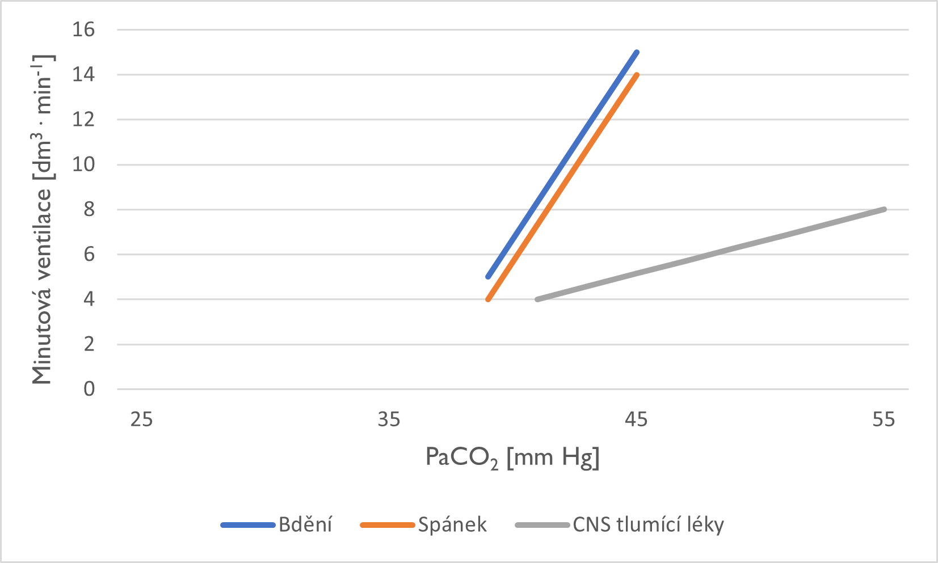
Respirační deprese vyvolaná opioidy (OIRD)
Tento graf byl upraven z Benner A, Sharma S. Physiology, carbon dioxide response curve. Treasure Island: StatPearls; 2020 pod podmínkami Creative Commons Attribution 4.0 International License (https://creativecommons.org/licenses/by/4.0/).

Slide 4
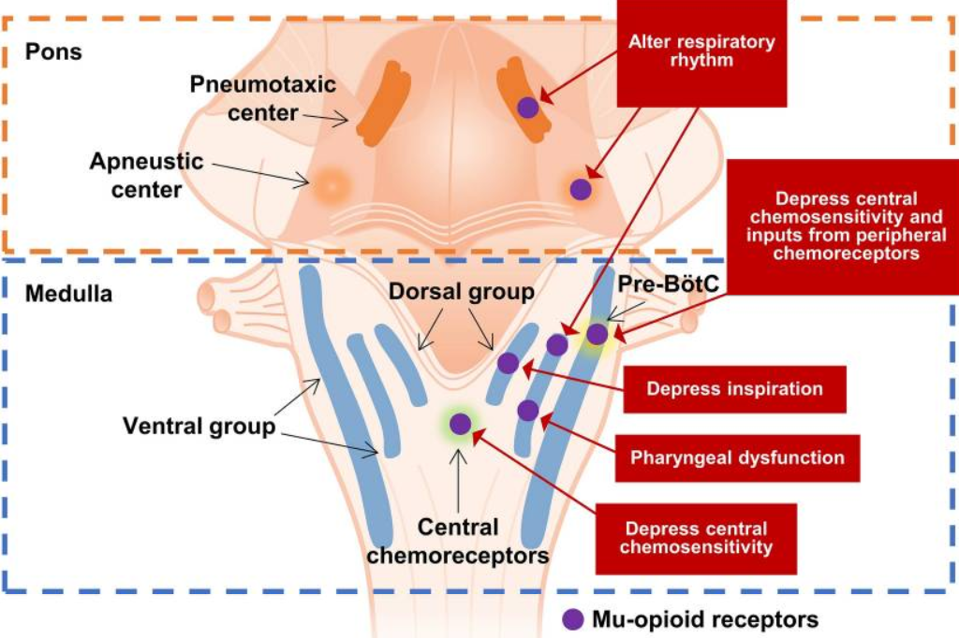
Výskyt mu-opioidních receptorů
Tento obrázek byl převzat z Webster LR, Karan S. The Physiology and Maintenance of Respiration: A Narrative Review. Pain Ther. 2020 pod podmínkami Creative Commons Attribution 4.0 International License (https://creativecommons.org/licenses/by/4.0/).

Slide 5
Výskyt mu-opioidních receptorů
Tento obrázek byl převzat z Webster LR, Karan S. The Physiology and Maintenance of Respiration: A Narrative Review. Pain Ther. 2020 pod podmínkami Creative Commons Attribution 4.0 International License (https://creativecommons.org/licenses/by/4.0/).

Slide 6
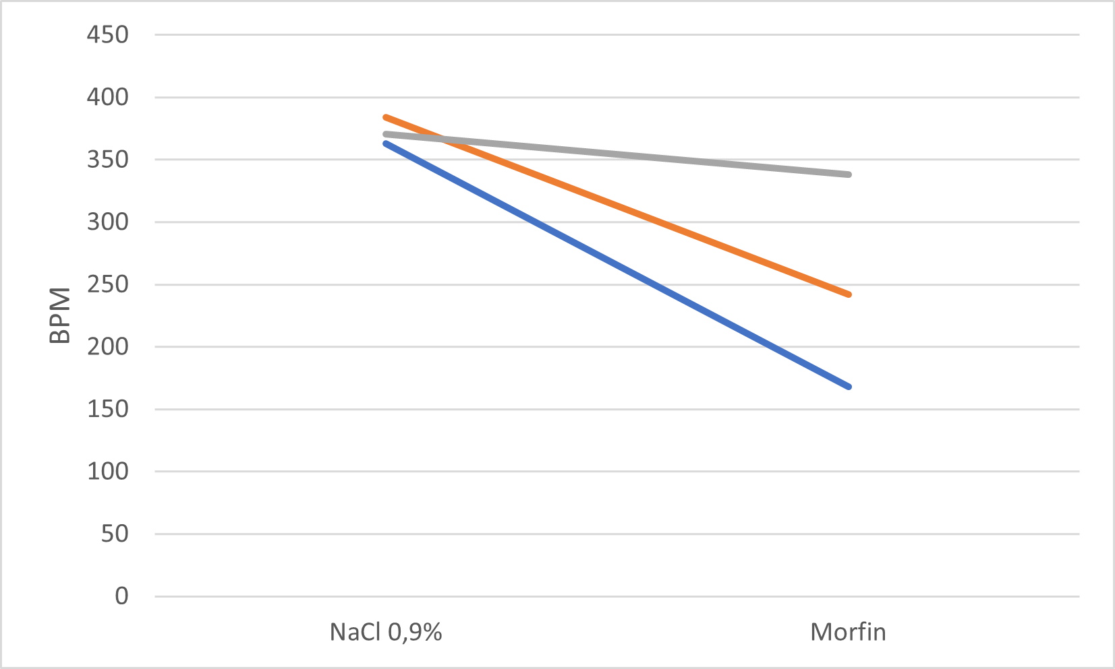
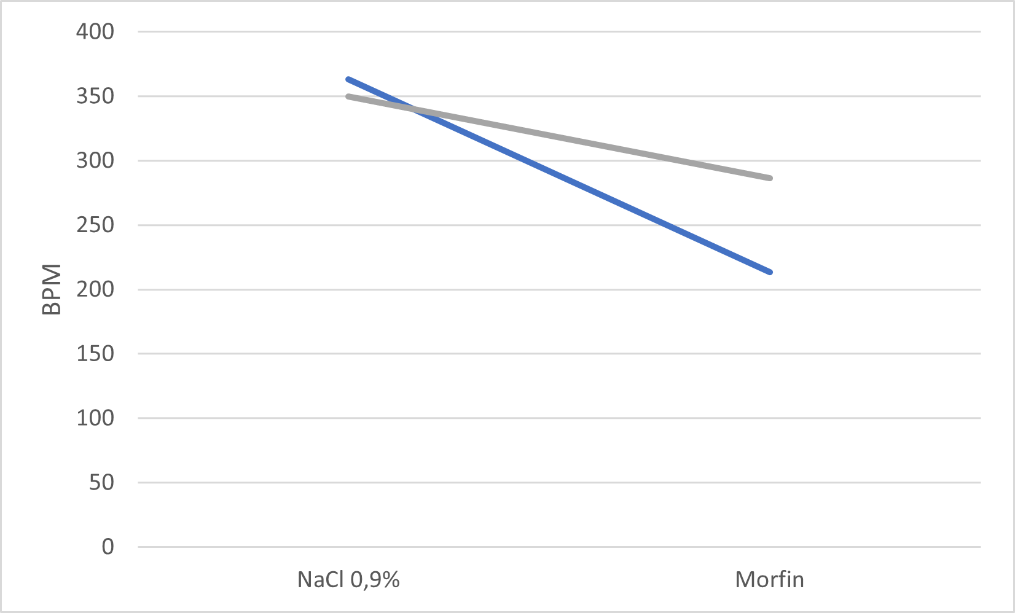
Úloha genu Oprm1 V OIRD
Globální Oprm1 knock out
PBL cílený Oprm1 knock out
[BPM] | +/+ | +/- | -/-
NaCl 0,9% | 363,1 | 384,2 | 370,6
Morfin | 168,1 | 242,2 | 337,9
[BPM] | +/+ | +/- | -/-
NaCl 0,9% | 363 | - | 350
Morfin | 213,4 | - | 286,6
Data z LIU, Shijia, Dong-Il KIM, Tae Gyu OH, et al. Neural basis of opioid-induced respiratory depression and its rescue. Proceedings of the National Academy of Sciences [online]. 2021, 118(23). ISSN 0027-8424. Dostupné z: doi:10.1073/pnas.2022134118

Slide 7
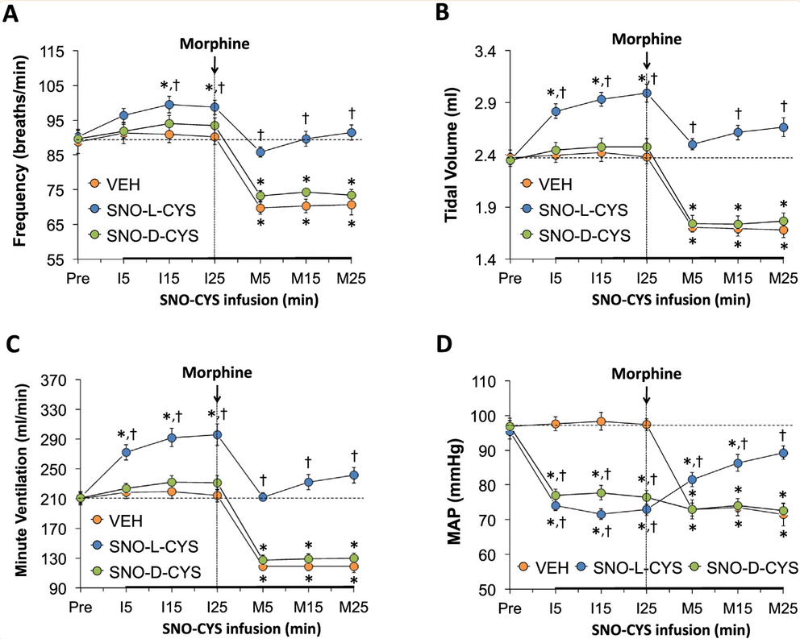
S-nitroso-L-cystein
Tyto grafy byly převzaty z GETSY, Paulina M., Alex P. YOUNG, James N. BATES, et al. S-nitroso-L-cysteine stereoselectively blunts the adverse effects of morphine on breathing and arterial blood gas chemistry while promoting analgesia. Biomedicine & Pharmacotherapy [online]. 2022, 153. pod podmínkami Creative Commons Attribution 4.0 International License (https://creativecommons.org/licenses/by/4.0/).

Slide 8
WEBSTER, Lynn R. a Suzanne KARAN. The Physiology and Maintenance of Respiration: A Narrative Review. Pain and Therapy [online]. 2020, 9(2), 467-486. ISSN 2193-8237. Dostupné z: doi:10.1007/s40122-020-00203-2
Benner A, Lewallen NF, Sharma S. Physiology, Carbon Dioxide Response Curve. 2022 Jul 19. In: StatPearls [online]. Treasure Island (FL): StatPearls Publishing; 2022 Jan–. PMID: 30844173.
LIU, Shijia, Dong-Il KIM, Tae Gyu OH, et al. Neural basis of opioid-induced respiratory depression and its rescue. Proceedings of the National Academy of Sciences [online]. 2021, 118(23) [cit. 2023-01-15]. ISSN 0027-8424. Dostupné z: doi:10.1073/pnas.2022134118
GETSY, Paulina M., Alex P. YOUNG, James N. BATES, et al. S-nitroso-L-cysteine stereoselectively blunts the adverse effects of morphine on breathing and arterial blood gas chemistry while promoting analgesia. Biomedicine & Pharmacotherapy [online]. 2022, 153. ISSN 07533322. Dostupné z: doi:10.1016/j.biopha.2022.113436

